Slide 1

Alert Watch and Response Engine (AWARE)
Alert Tracker Training
Ralph H Johnson VA Medical Center
Charleston, SC
June 2014
CLIN 0009AC

Slide 2
Contents
Lesson 1: What is the Alert Tracker?
Overview of the Alert Tracker
Lesson 2: Using the Alert Tracker
How the Alert Tracker Works
Alert Tracker Prompt
Deferring Alerts
Addressing Alerts
Selecting a VEFA Template
Selecting Follow-Up Actions
Completing Orders
Signing the Progress Note
Finishing the Process
Contact Information

Slide 3
Purpose and Objectives
Objective: To provide an overview, basic training, and examples of how to use the Alert Tracker
After completing this training:
All users should be able to use the Alert Tracker and understand how it fits into their alert management workflow

Slide 4
Lesson 1: What Is the Alert Tracker?

Slide 5
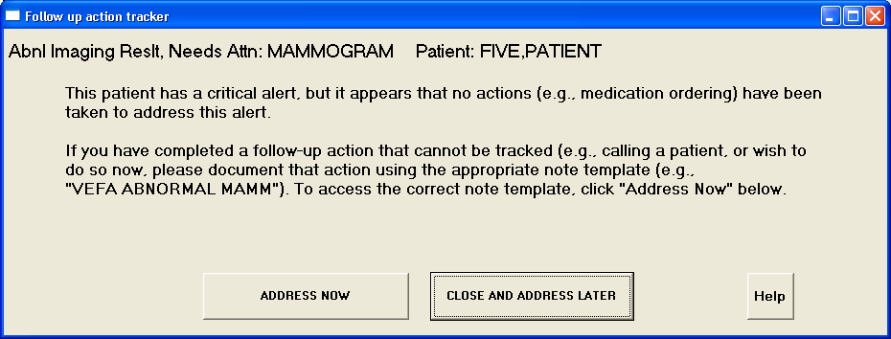
Overview
The Alert Tracker is the core part of the AWARE system and serves as the CPRS integration point.
The Alert Tracker has been designed to work with CPRS v29.
It prompts clinicians for timely follow-up actions on certain critical alerts that may have been missed.
Alert Tracker CPRS Prompt

Slide 6
Overview
Currently, the Alert Tracker only tracks these four critical alerts:
Prostate Specific Antigen (PSA)
Fecal Occult Blood Test (FOBT)
Abnormal Imaging
Abnormal Mammogram
Clinical Application Coordinators (CACs) at your facility will configure the Alert Tracker according to your facility’s policies for these alerts.

Slide 7
Lesson 2: Using the alert tRacker

Slide 8
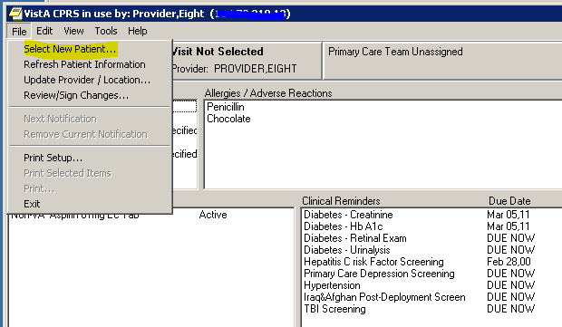
How the Alert Tracker Works
You, a CPRS user, finish looking at a patient’s record and attempt to closeout or go to a different patient’s chart.
Before you leave the current patient’s chart, a CPRS function determines whether that patient has any of the four tracked critical alerts that do not yet have a follow-up action associated with them.
CPRS Patient Chart – Select New Patient

Slide 9
How the Alert Tracker Works
If a tracked alert exists and there are no follow-up actions in the patient’s chart, the Alert Tracker prompt appears on the screen, giving you the opportunity to address the alert now.
From that prompt, you can choose to indicate one or more preferred follow-up actions (e.g., a repeat test or medication order) and be directed to the specific CPRS functions associated with those actions.
Alert Tracker CPRS Prompt

Slide 10
How the Alert Tracker Works
Note: The Alert Tracker prompt will only appear when you are attempting to leave a patient’s chart for whom there is a tracked critical alert AND for whom no follow-up action has been taken.
The Alert Tracker prompt will NOT display for any other non-tracked critical alerts.
The Alert Tracker prompt will NOT display if the tracked critical alert has already been followed-up by you or someone else on the patient’s care team.

Slide 11
Alert Tracker Prompt
If you wish to defer follow-up actions until later, you can click the Close and Address Later button. In this case, the alert will remain active and the prompt will appear again when you visit this patient’s chart.
If you choose to address the alert now, click the Address Now button on the prompt.
Alert Tracker CPRS Prompt

Slide 12
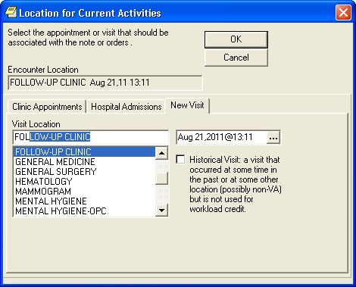
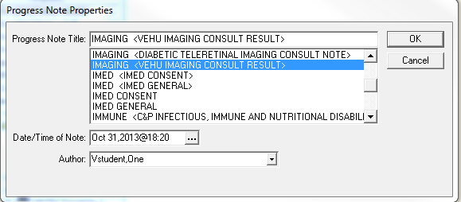
Selecting a VEFA Template
Clicking Address Now will bring up the Visit Location dialog window shown at right.
Select the correct visit location from the dropdown list and click OK.
In dialog that appears next (shown below at right), select the appropriate Progress Note Title from the dropdown list.

Slide 13
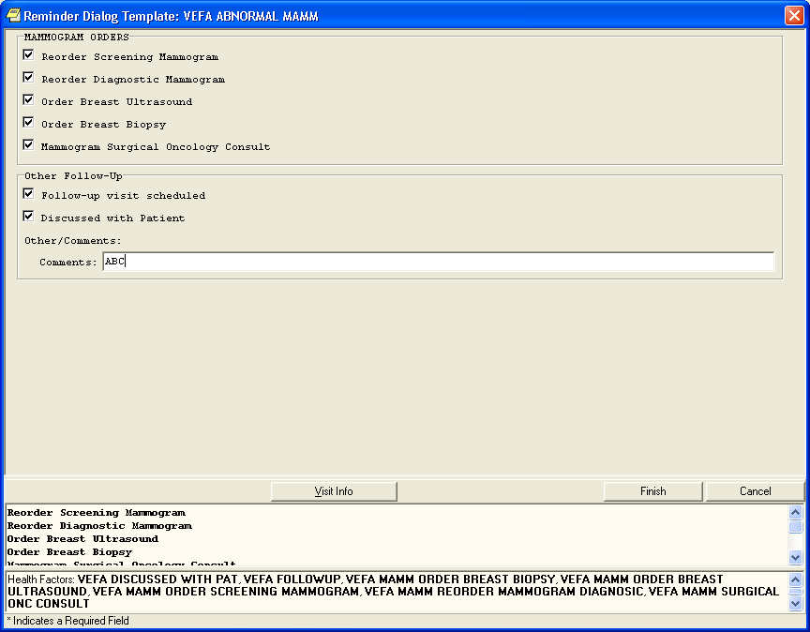
Selecting Follow-Up Actions
In the resulting reminder dialog, select all appropriate follow-up actions you wish to perform (or have already performed and wish to document).
CACs at your facility will configure which follow-up actions are displayed here.

Slide 14
Selecting Follow-Up Actions
The window at the bottom of the dialog shows all items you have selected and all notes you have entered in the Comments field.
These will appear in the progress note that is generated in the patient’s chart.

Slide 15
Completing Orders
If you selected any orders on the reminder dialog, you will automatically be prompted to enter those order details, just as you would in other instances of CPRS.
Complete these details to place the orders and therefore satisfy the Alert Tracker condition.
The appropriate health factors associated with each follow-up action will then be added to the patient’s chart.

Slide 16
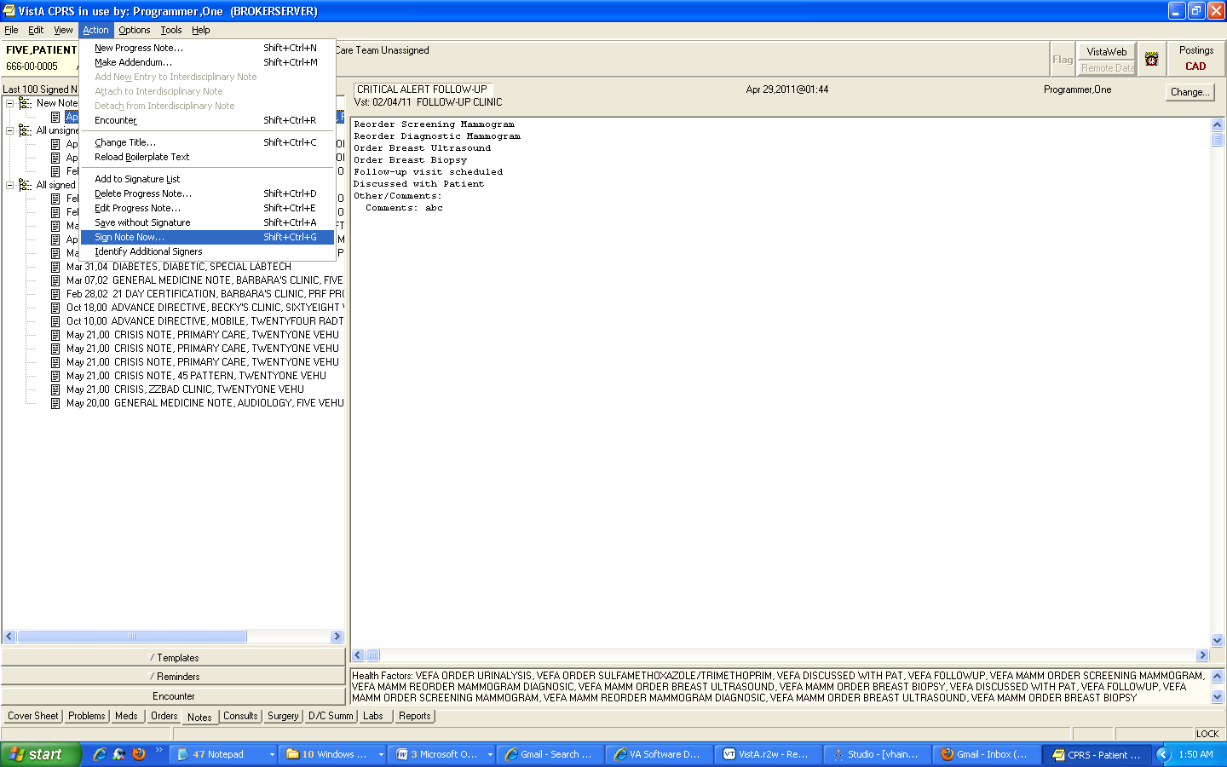
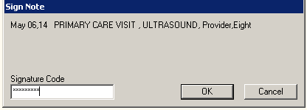
Signing the Progress Note
Review the progress note that was generated and add any additional notes as necessary.
Then, sign the note and any outstanding orders as usual.

Slide 17
Finishing the Process
When the progress note and all associated orders have been signed, the Alert Tracker condition will be satisfied, and the prompt will no longer appear on patient closeout for that alert instance.
Only then will the critical alert be removed from your list.

Slide 18
Contact Information

Slide 19
Contact Information
If you have questions or need additional assistance, contact:
CAC Support:
Margaret Fralin (Margaret.Fralin@va.gov)
Patrick McGillicuddy (Patrick.McGillicuddy@va.gov)
AWARE Technical Support:
awarespprt@gmail.com

